Slide 1
DLRG Application EYLC 2024
DLRG – Application EYLC 2024

Slide 2
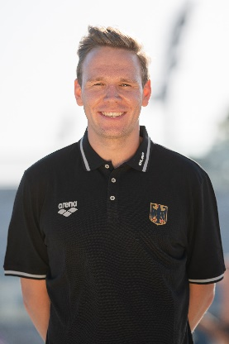
DLRG Application EYLC 2024 - Introduction
Kai Schirmer
DLRG Employee
Technical Director – Sport
Head of Department – Lifesaving Sport
on behalf of Carsten Schlepphorst
DLRG Board member
ILSE Sportscommisson
DLRG – Application EYLC 2024

Slide 3
DLRG Application EYLC 2024 - Agenda
The Application
Pool Venue
Ocean/ Beach Venue
Timeline
Accommodation
Organization Chart
Questions/ Discussion
DLRG – Application EYLC 2024

Slide 4
DLRG Application EYLC 2024
The Application
Pool Venue
Ocean/ Beach Venue
Timeline
Accommodation
Organization Chart
Questions/ Discussion
DLRG – Application EYLC 2024

Slide 5
DLRG Application EYLC 2024 - The Application
Friday 28th June – Friday 5 th July
28th Arrival and Training
29th Training SERC & OC
30th – 1 st Pool Competition
2 nd Travel & Training Day
3 rd – 4 th Ocean Competition, VC
Fr 5 th Departure
DLRG – Application EYLC 2024

Slide 6
DLRG Application EYLC 2024 - The Application
Pool Day 1,
100m Manikin Carry with Fins
4x50m Medley Relay
50m Manikin Carry
4x25m Manikin Relay
200m Super Lifesaver
4x50m Mixed Pool Lifesaver Relay
Pool Day 2,
200m Obstacle Swim
4x50m Obstacle Relay
Line Throw
100m Manikin Tow with Fins
100m Rescue Medley
Ocean Day 3,
Beach Sprint
Beach Relay
Surf Race (Straight Final)
Board Rescue
Ocean(wo)man
Ocean(wo)man Relay (Straight Final)
Ocean Day 4,
Beach Flags
Board Race
Rescue Tube
Surf Ski Race
Ocean Lifesaver Relay Mixed (Straight Final)
DLRG – Application EYLC 2024

Slide 7
DLRG Application EYLC 2024
The Application
Pool Venue
Ocean/ Beach Venue
Timeline
Accomodation
Organization Chart
Questions/ Discussion
DLRG – Application EYLC 2024

Slide 8
DLRG Application EYLC 2024 - Pool Venue
City of Riesa:
30.000 Citizens
Close to River Elbe
National Train Station
International Airport: Leipzig-Dresden
Regional Championships Lifesaving
Several Hotels & Pensions
DLRG – Application EYLC 2024

Slide 9
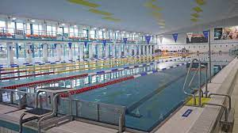
DLRG Application EYLC 2024 - Pool Venue
Competition Pool: Pool Events & SERC
8x50m
8 Standard Blocks (Plan: new Version)
1,80m depth
ILS sanctioned before
Regional Championships Lifesaving
DLRG – Application EYLC 2024

Slide 10
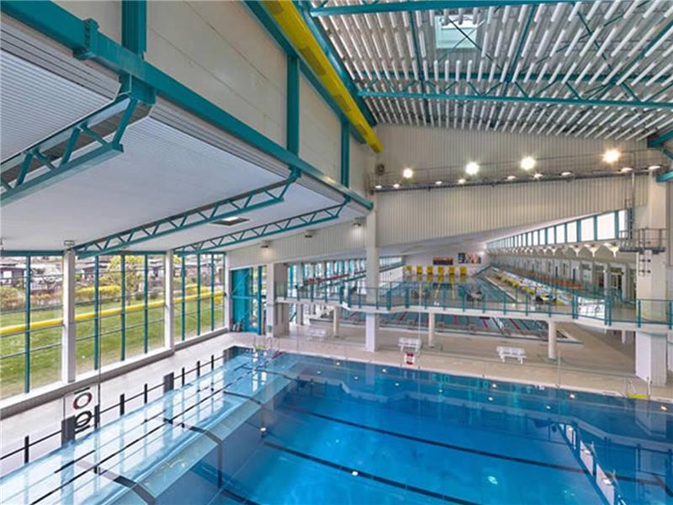
DLRG Application EYLC 2024 - Pool Venue
Cool Down/ Warm Up Pool:
6x25m
no Blocks
1,50-5,00m
Open all the Time
DLRG – Application EYLC 2024

Slide 11
DLRG Application EYLC 2024
The Application
Pool Venue
Ocean/ Beach Venue
Timeline
Accomodation
Organization Chart
Questions/ Discussion
DLRG – Application EYLC 2024

Slide 12
DLRG Application EYLC 2024 - Ocean/ Beach Venue
Region of Geiseltalsee:
four Cities at the Shore
famous for Water sports
old opencast Mine
National Train Station: Halle/ Saale
International Airport: Leipzig-Dresden
Regional Championships Lifesaving
Several Pensions
Hotel Booking in the City of Halle
DLRG – Application EYLC 2024

Slide 13
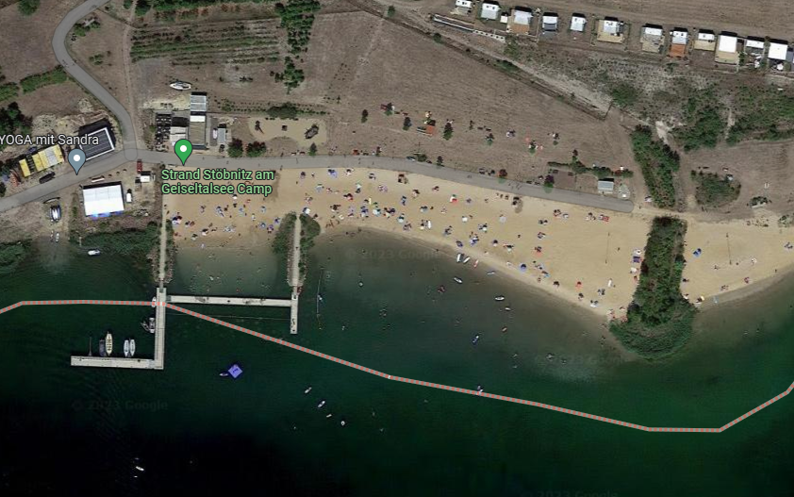
DLRG Application EYLC 2024 - Ocean/ Beach Venue
Competition Office,
Victory Ceremonies,
Closing Ceremony,
Lunch,
Crafttrailers,
Rental Craft
Beach Area
Water Area
DLRG – Application EYLC 2024

Slide 14
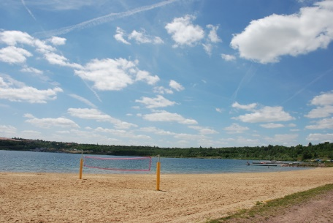
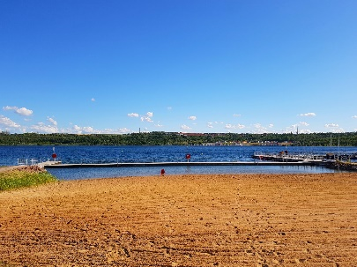
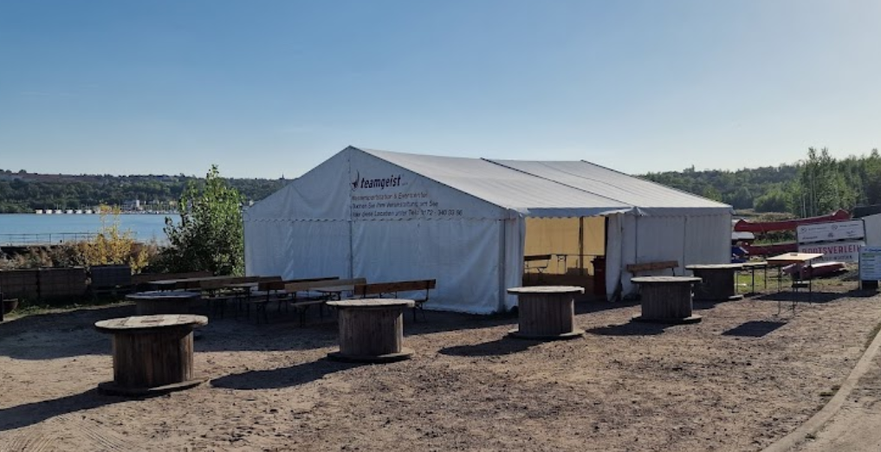
DLRG Application EYLC 2024 - Ocean/ Beach Venue
Beach Area
Bigger Tent: Lunch, VC, CC,
DLRG – Application EYLC 2024

Slide 15
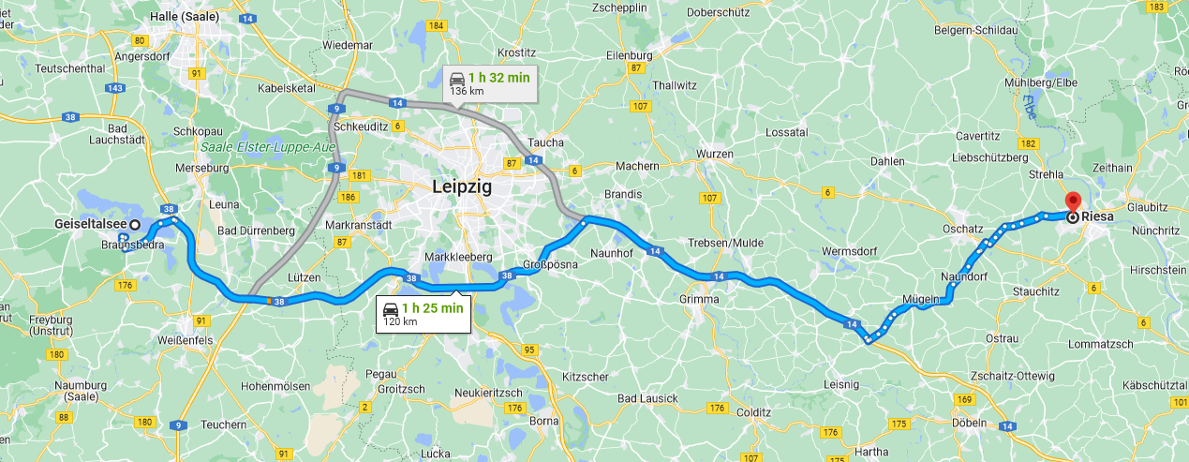
DLRG Application EYLC 2024 – Pool/ Ocean Venue
120 km
1h25 Min
DLRG – Application EYLC 2024

Slide 16
DLRG Application EYLC 2024
The Application
Pool Venue
Ocean/ Beach Venue
Timeline
Accommodation
Organization Chart
Questions/ Discussion
DLRG – Application EYLC 2024

Slide 17
DLRG Application EYLC 2024 - Timeline
Announcement/
Information
for
Federations
Inspection
by
ILSE
Confirmation
of
Local Contracts
EYLC 2024
Application
by
DLRG
Decision
by
ILSE
detailed
Plannings
Registration
for
Events
Evaluation
DLRG – Application EYLC 2024

Slide 18
DLRG Application EYLC 2024
The Application
Pool Venue
Ocean/ Beach Venue
Timeline
Accommodation
Organization Chart
Questions/ Discussion
DLRG – Application EYLC 2024

Slide 19
DLRG Application EYLC 2024 - Accommodation
no obligation of booking an Accommodation
Overview of Accommodations by DLRG
individual booking of arrival & departure at Accommodation
individual booking of Training
individual booking of Meals
Lunch on Competition Days (individual Booking)
Accommodation for LOC, OC and Officials & Referees
DLRG – Application EYLC 2024

Slide 20
DLRG Application EYLC 2024
The Application
Pool Venue
Ocean/ Beach Venue
Timeline
Accommodation
Organization Chart
Questions/ Discussion
DLRG – Application EYLC 2024

Slide 21
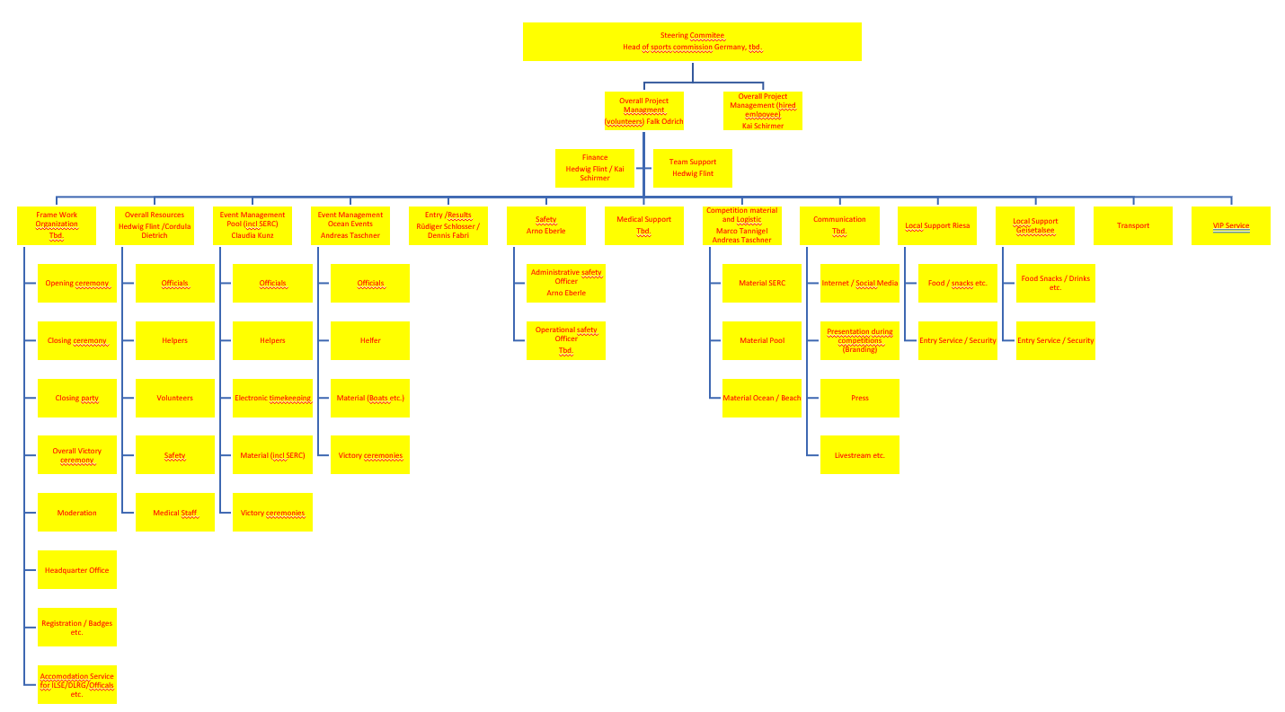
DLRG Application EYLC 2024 Organization Chart
DLRG Board member
Falk Odrich
Kai Schirmer
OVERVIEW
DLRG – Application EYLC 2024

Slide 22
DLRG Application EYLC 2024
The Application
Pool Venue
Ocean/ Beach Venue
Timeline
Accommodation
Organization Chart
Questions/ Discussion
DLRG – Application EYLC 2024

Slide 23
DLRG Application EYLC 2024 - Questions/ Discussion
DLRG – Application EYLC 2024

